Slide 1



Slide 2
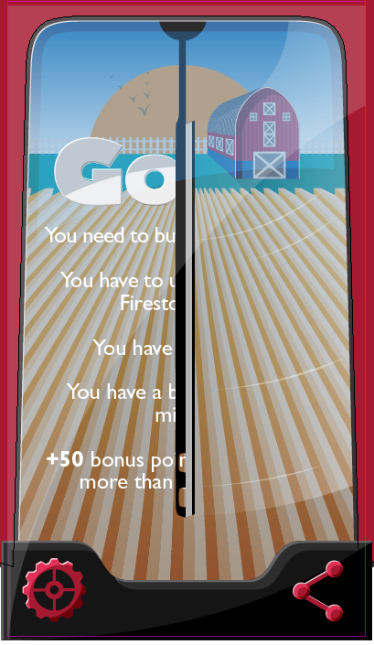
The idea is to change landscapes trough on each mission. The landscape could be related with the event the player accomplished (for ex. China, Africa or Europe landscape). This is a suggestion we would like to consult.

Slide 3
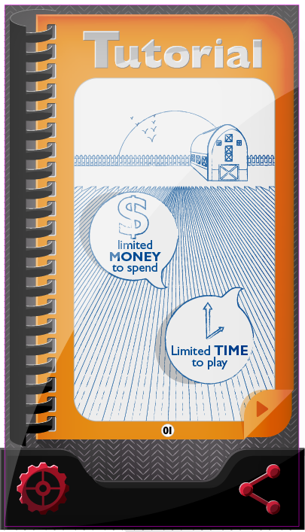
The tutorial would be defined as we finish the game design

Slide 4
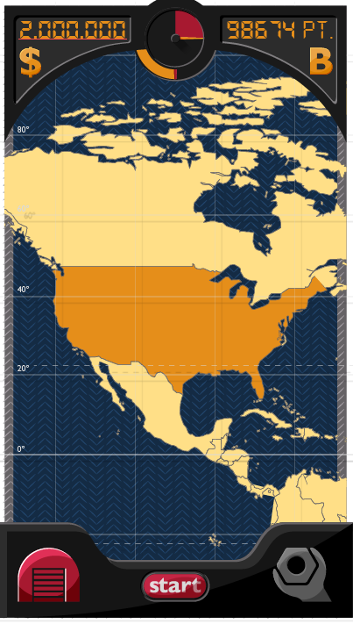
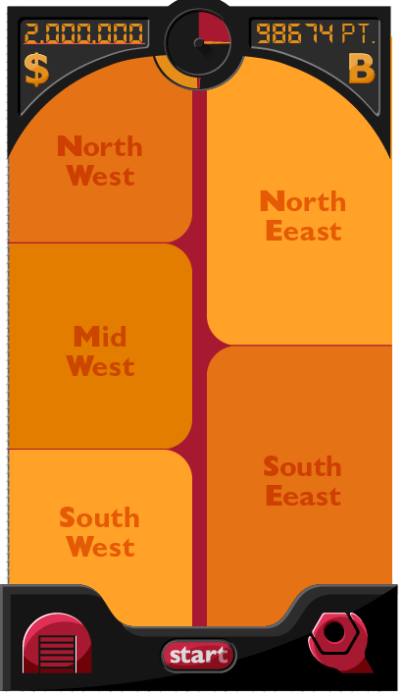
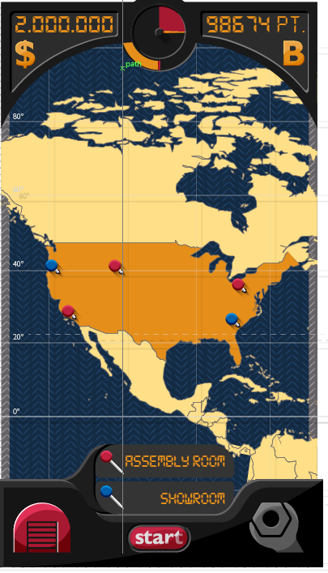

Slide 5
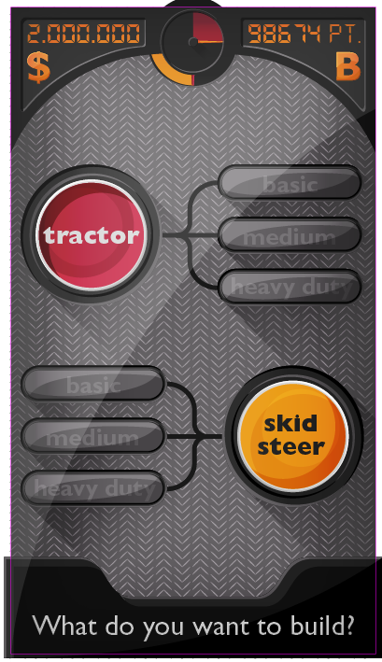
We made this screen, but we had another better idea that we would like to try.

Slide 6
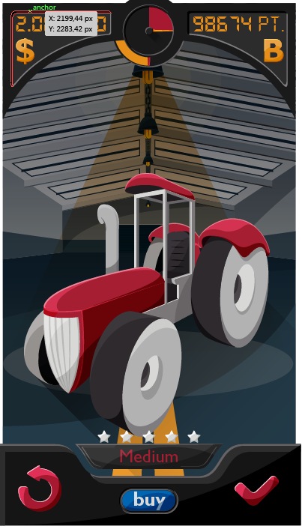

Slide 7
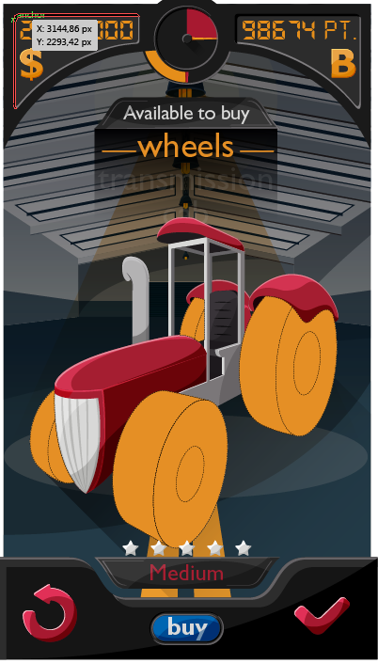
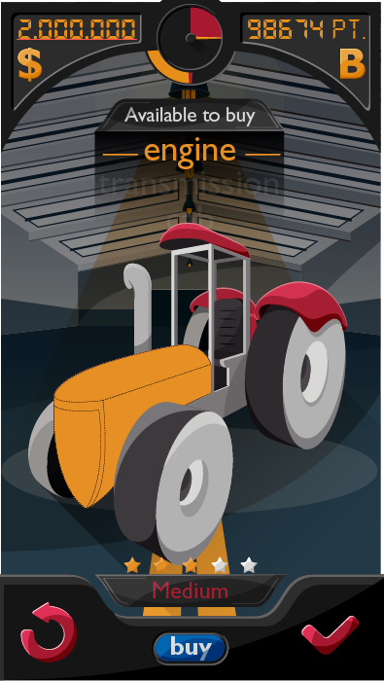
Menu to choose what to buy, up and down scroll
Stars will show what kind of medium tractor I am building. We won’t show the change in the tractor/skid because the combination is endless
While going through the menu, parts to change get lighted

Slide 8
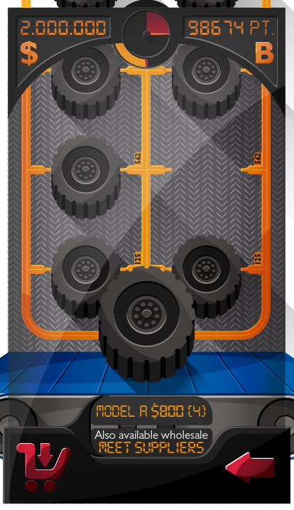
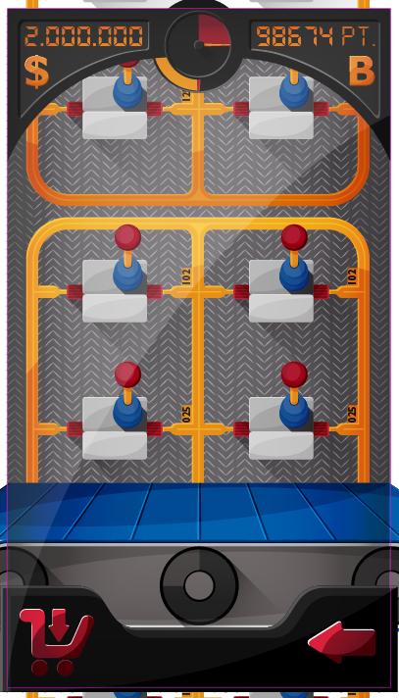
One player picks up the part he would like to buy, put it on the conveyor belt
This menu shows the model, prize and offer, also shows wholesale

Slide 9
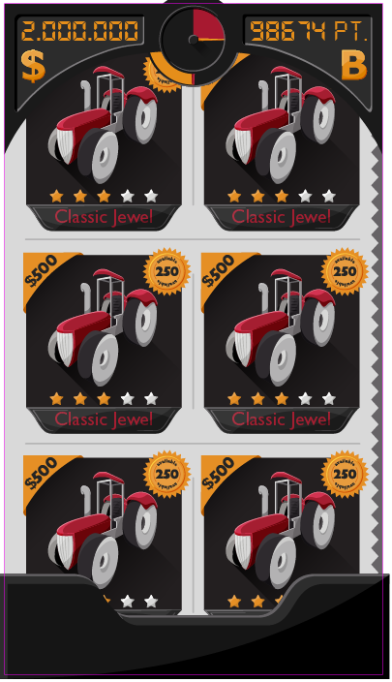
The idea of the showroom is to look like as a classified magazine, showing model, price and availability

Slide 10
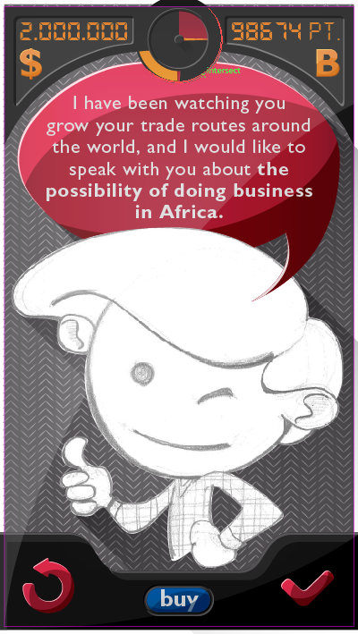
We are still defining characters

Slide 11
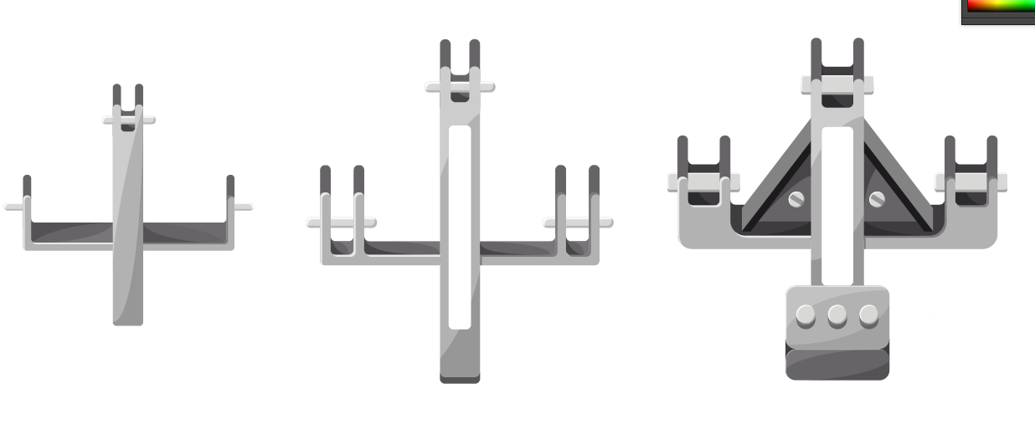
Parts

Slide 12
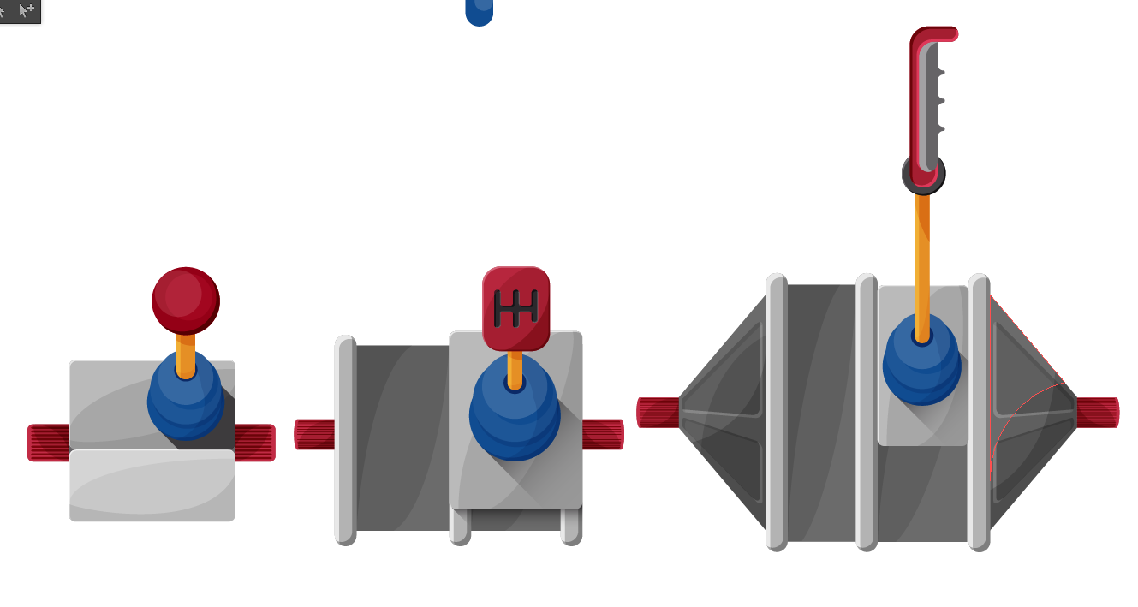

Slide 13
